Slide 1
Buy It Now Surplus PC Pricing
Please contact our surplus specialist for availability
Worth allen
859-572-5119
allenw1@mymail.nku.edu
Or
Ryan Straus
strausr2@nku.edu

Slide 2
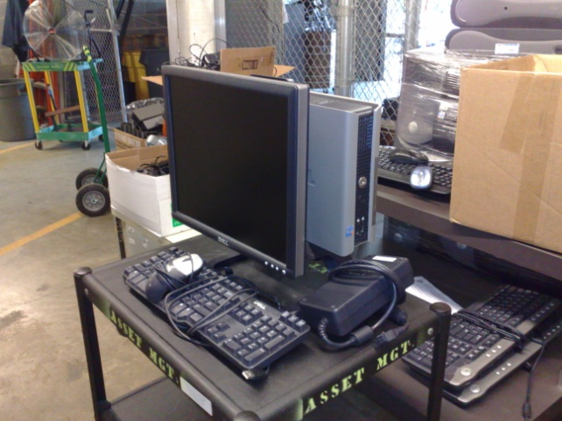
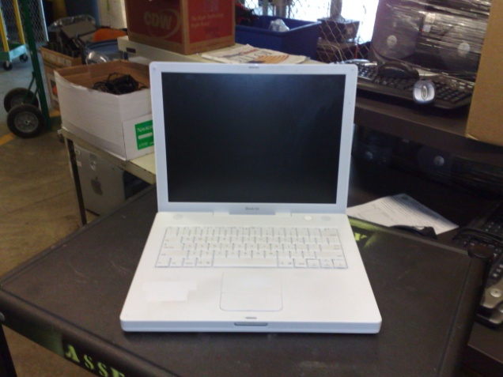
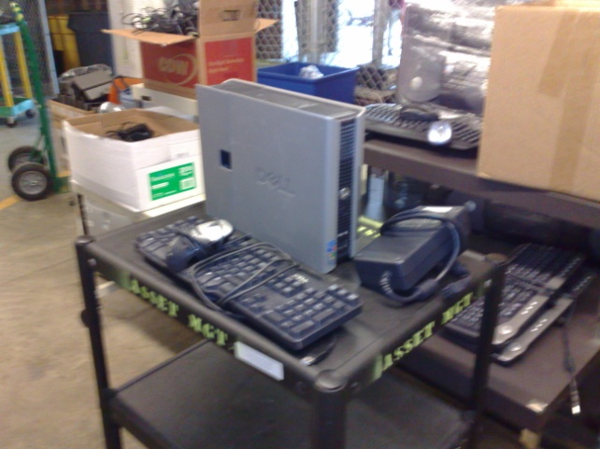
Compact Dell Optiplex GX 280 W/ Monitor
$100.00
All Laptops (I Book, Dell Latitudes)
Depending on Availability
$100.00
Compact Dell Optiplex GX 280
$50.00
Compact Dell Optiplex GX 620
$75.00
Compact Dell Optiplex GX 745 +
$100.00
If Available All Computers come with keyboard, mouse and Power Cord

Slide 3
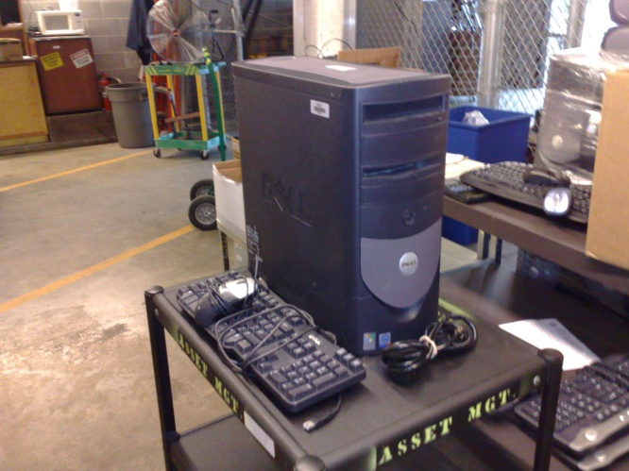
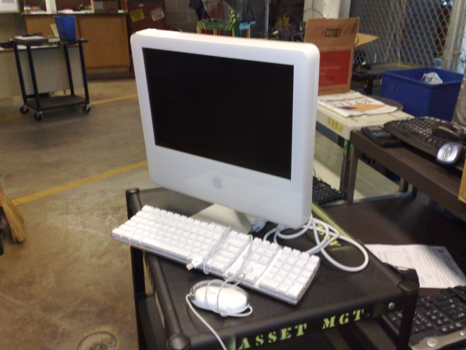
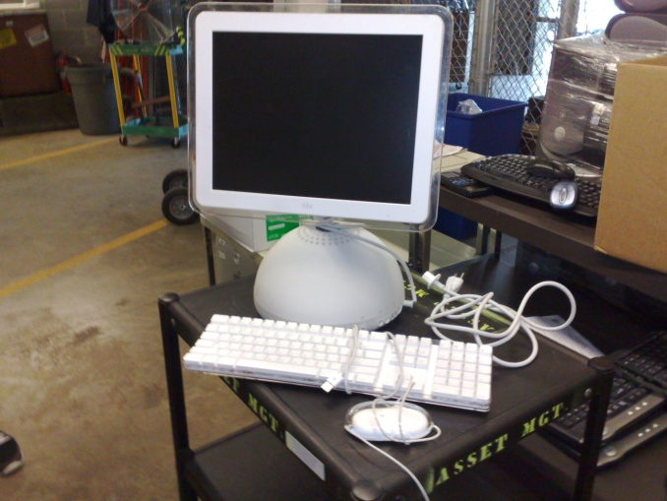
Dell Optiplex GX 280
$50.00
Dell Optiplex GX 620
$75.00
Dell Optiplex GX 745 +
$100.00
I Mac G5
$100.00
I Mac G4
$75.00
If Available All Computers come with keyboard, mouse and Power Cord

Slide 4
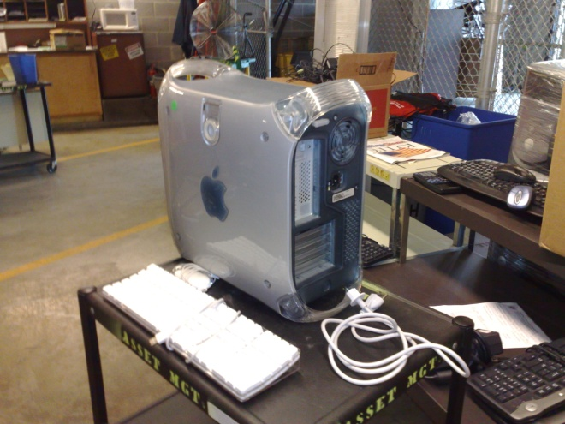
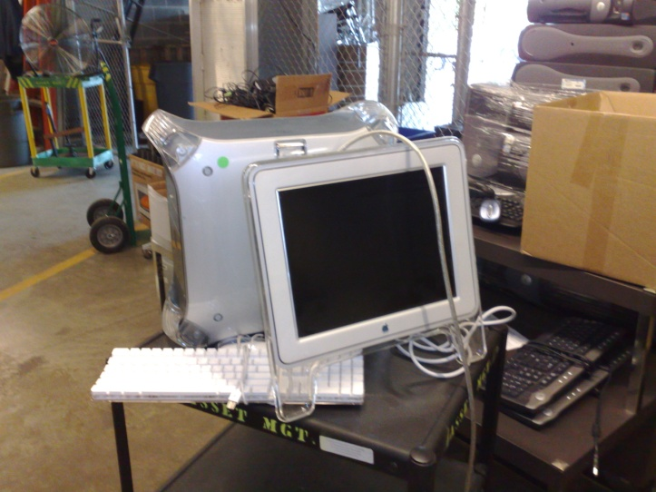
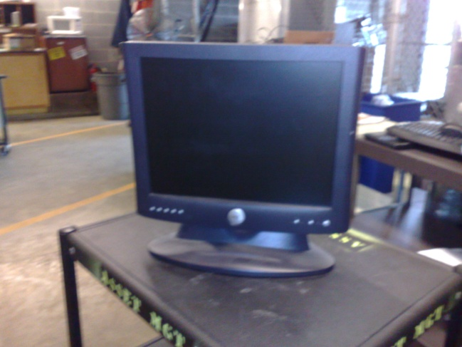
I Mac G4 Tower
$50.00
I Mac G4 Tower With Monitor and
G5 Tower No Monitor
$75.00
All Monitors
$25.00
If Available All Computers come with keyboard, mouse and Power Cord

