Slide 1
PaymentWorks Vendor Onboarding Solution August 2020
Workshop & Overview

Slide 2
New Process Drivers
Risk Concerns
Fraud, Risk Management
Internal control requirements and audit requirements
Current paper-driven process is very inefficient manual entry

Slide 3
What is PaymentWorks?
PaymentWorks is a cloud-based onboarding application for automating the vendor registration process
Departmental users are empowered to extend invitations to vendors to register, and to have visibility into onboarding process
Vendors will register and maintain their own information through an assigned self-service account
Currently utilized at a number of higher education institutions including University of Kentucky, John Hopkins, UC Davis

Slide 4
Empowerment for Departments
Departments are empowered to create and send their own invitations to vendors to registered
Department users have quick and easy access to PaymentWorks through the myNKU environment
Departments can see full process and status as vendors are onboarded and receive vendor numbers in their dashboard when assigned

Slide 5
Self-Service For Vendors in Payment Works
Vendors complete a registration form and are responsible for their information. The vendor is responsible for accurate registration information.
They can also request their preferred payment type and in some cases, enter/manage their own ACH and other banking data.
Vendors complete their own updates such as address changes, company merger or acquisition, diversity status, etc. reducing entries on by University staff.

Slide 6
Who Will Register For A Vendor Number
Any new business, organization, or individual who previously would complete a paper vendor application will use PaymentWorks. This includes any entity for whom a Requisition or PVI would be initiated:
US Business or Individuals
Foreign Business or Individuals
Non-Profits or Government Entities
Student Organizations
Foreign Persons Utilizing W8-BEN Forms

Slide 7
Who Will Not Register For A Vendor Number
Faculty, Staff and Students will not register within PaymentWorks.
They will continue to use the paper-based vendor form and send to Procurement Services.
New Employee vendor form link – available on the Procurement Services website

Slide 8
Current University Database File in SAP
Existing active vendors in SAP will continue to be available for Requisitions and PVI, etc.
Continue to first search for an existing vendor in SAP as normal.
Only use PaymentWorks to onboard a new vendor who is not currently in the University’s SAP system.

Slide 9
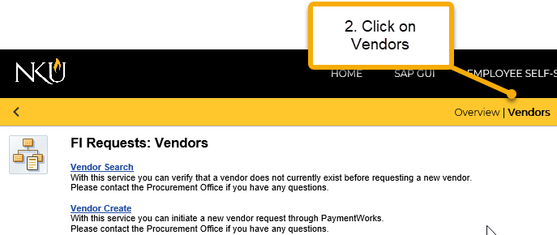
PaymentWorks Tour To request a vendor be added to the University vendor database, access myNKU under – FI REQUEST TAB

Slide 10
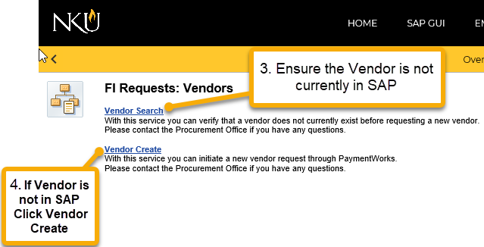
Login To PaymnetWorks Make sure the Vendor you need is not currently in SAP by Clicking Vendor Search

Slide 11
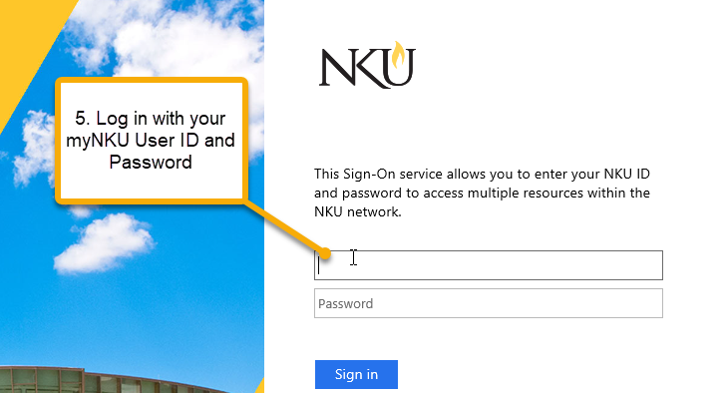
Login To PaymentWorks Login via Single Sign-On(SSO) screen with your NKU USER ID and Password (the same as you do for any NKU application)

Slide 12
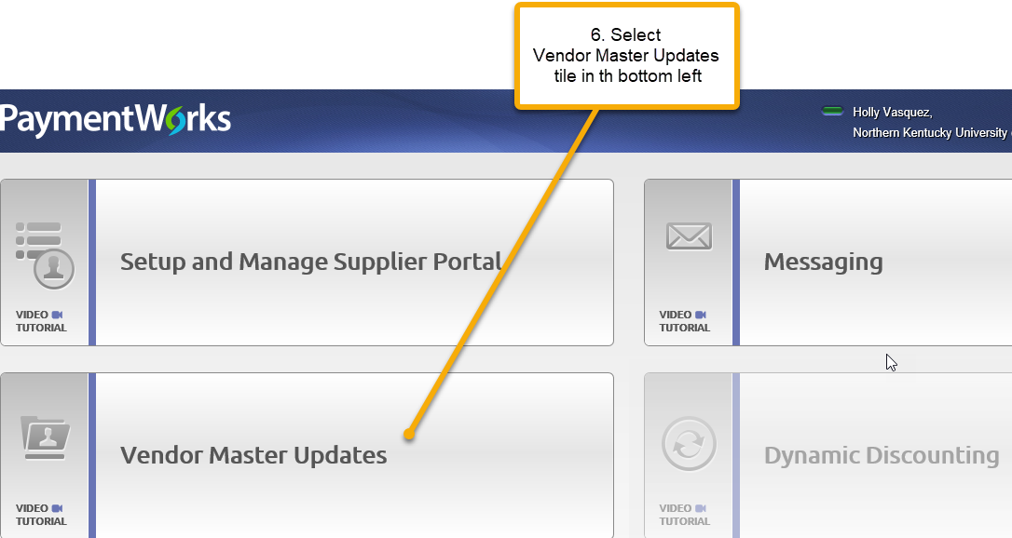
Arrive At PaymentWorks The NKU user will arrive at the PaymentWorks home screen and select Vendor Master Updates tile

Slide 13
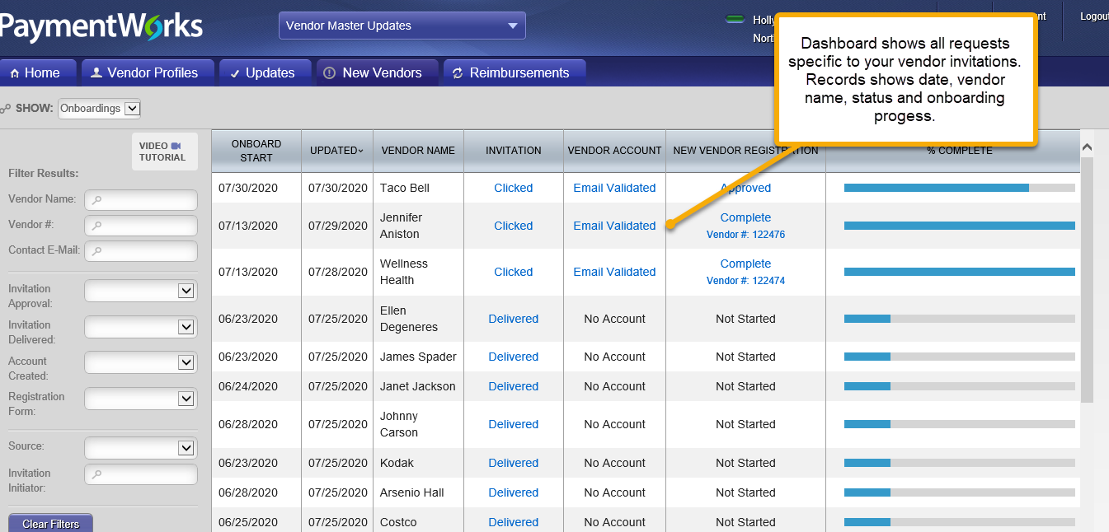
PaymentWorks Dashboard Each NKU user has a PaymentWorks dashboard unique to their vendor requests

Slide 14
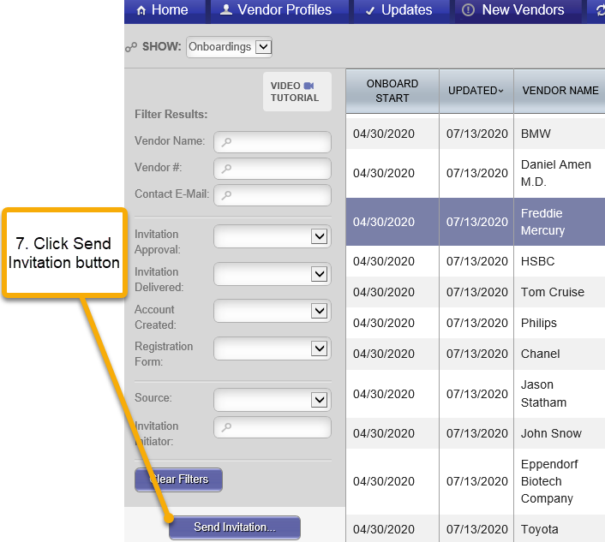
Send Invitation to Vendor The NKU user sends an invitation directly to a vendor via email

Slide 15
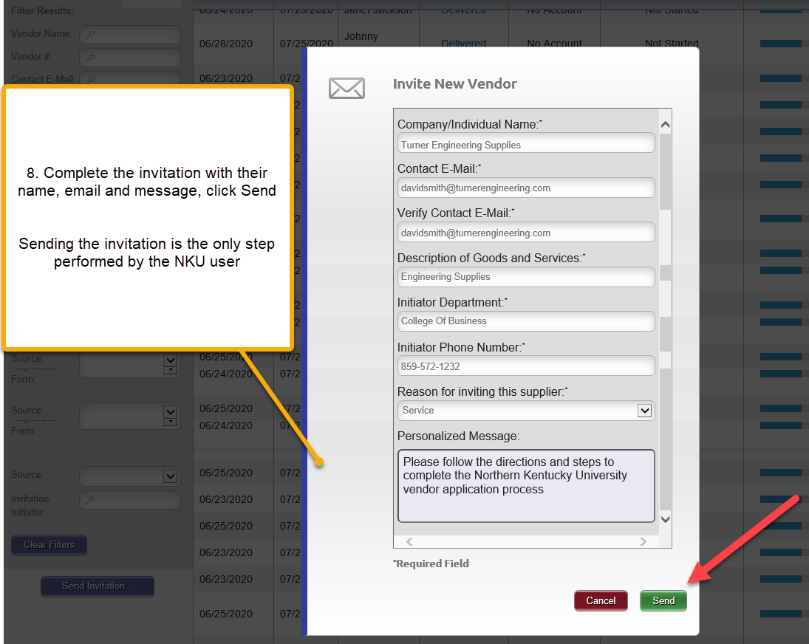
Complete The Invitation Complete the invitation to the vendor to become registered

Slide 16
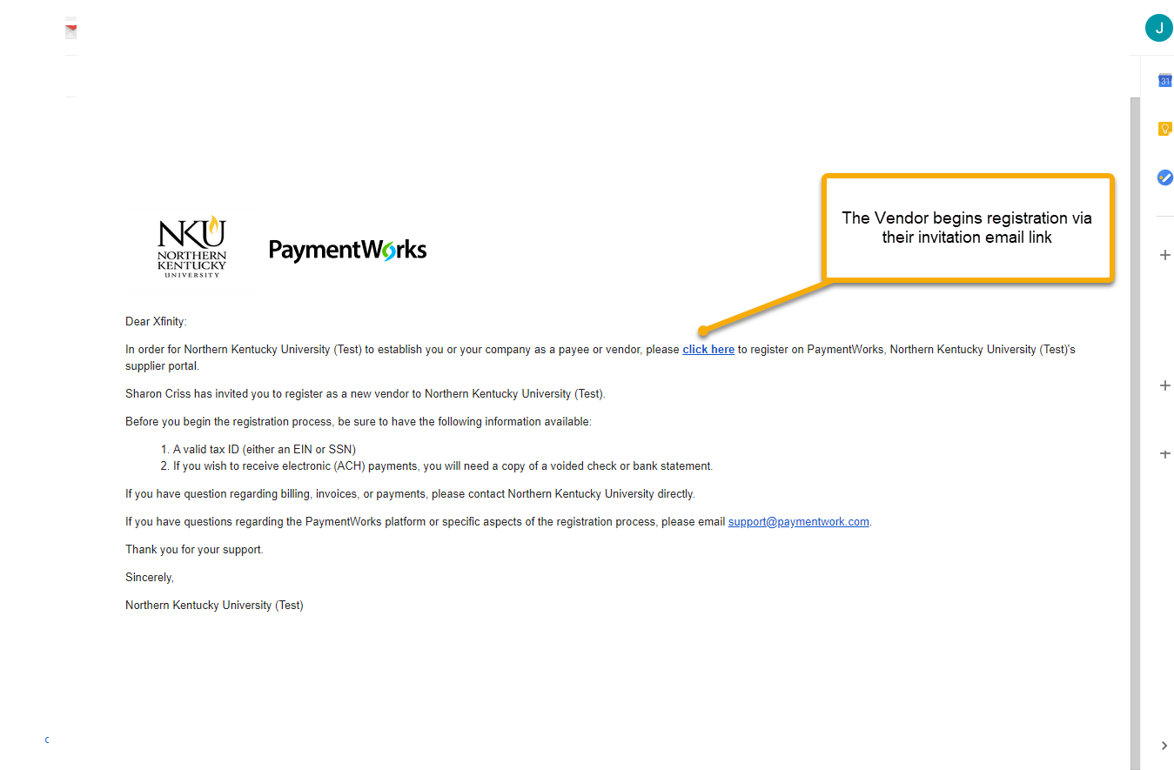
Vendor Receives Email Invitation The vendor will receive the email invitation with a link to begin the registration process.

Slide 17
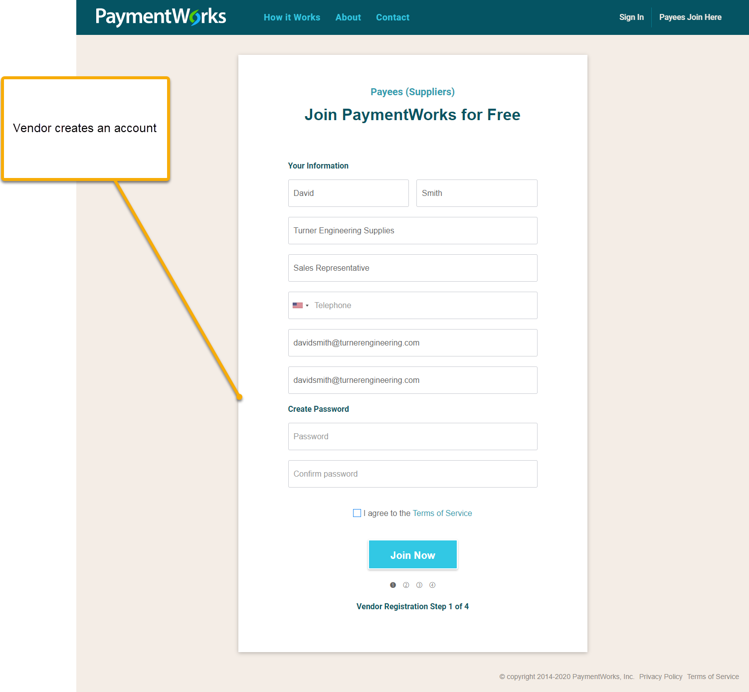
Vendor Creates Account Vendor will create an account through the link and follow the steps to register. There is no charge to vendor register.

Slide 18
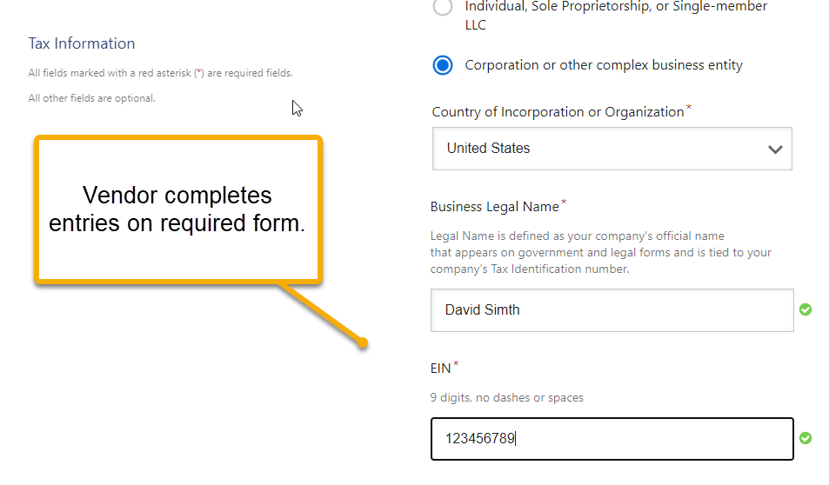
Vendor Completes Registration Process Vendor completes the online application process. This is customized for all University vendor types.

Slide 19
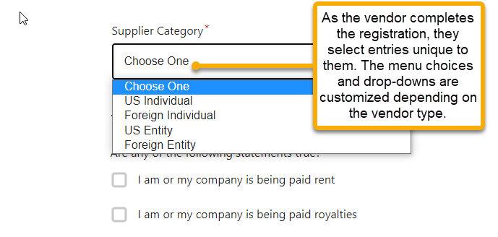
Vendor Completes Registration Process

Slide 20
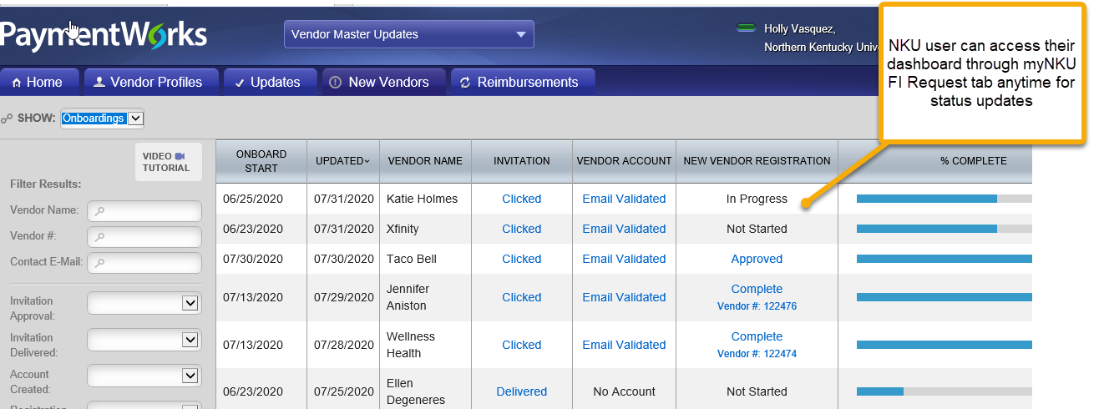
NKU User Dashboard The departmental user’s dashboard shows all their vendor invitations with status updates.

Slide 21
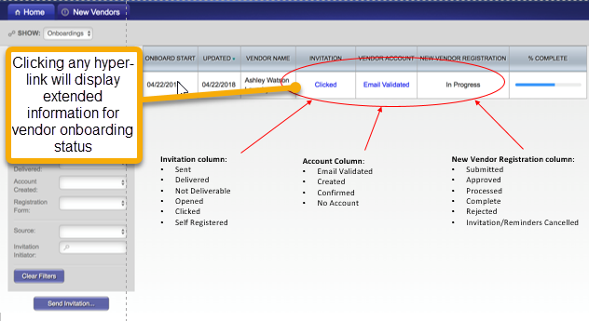
NKU User Tracking OnBoardings NKU users can track the progress of the vendor onboarding status

Slide 22
Vendor Number Assigned Upon Completion When the vendor is fully onboarded, the University vendor number will appear under the NEW VENDOR REGISTRATION column.

Slide 23
Vendor Number Assigned Upon Completion Once a vendor number is created and the vendor is connected in Payment Works, the initiator (department) and the vendor will receive the confirmation below.
Example of email from PaymentWorks once vendor number is created
Pandora, Inc. has completed the registration process and now is set up in the ERP system. The following vendor number has been assigned: 122472 Vendor connected: Company Legal Name - Pandora, Inc. Company DBA - Pandora, Inc. Registration Submitted By - Mary Brown For more information about this or other invitations in PaymentWorks, please go to the "Onboardings" page in PaymentWorks. Best regards, PaymentWorks Support

Slide 24
Utilizing Your Dashboard If you see a vendor has not completed the registration, you can resend the invitation if desired. PaymentWorks also sends reminders to vendors automatically

Slide 25
Current Vendor Application No Longer Used The vendor application form will not be accepted in Procurement Services after August 13, 2020.
The current University vendor application will be removed from the Procurement Services website. PaymentWorks Go-Live date is planned for August 17, 2020.

Slide 26
Frequently Asked Questions
Question: What is the main change for me as a departmental employee with regard to PaymentWorks?
Answer: The main change is simply to use the PaymentWorks invitation process to request a new vendor rather than the paper-based vendor application.
Question: How will vendor updates be managed?
Answer: A new vendor onboarded through PaymentWorks will have the ability to update their own information. This updates the NKU SAP vendor database.

Slide 27
Frequently Asked Questions
Question: How will employees and students be set up as vendors?
Answer: The process to set-up a employee or student will not change. As a reminder employees and students will not be set up in PaymentWorks.
A comprehensive list of FAQ is available on the Procurement website at:
https://inside.nku.edu/procurement/paymentworks.html

Slide 28
Help Resources
Departmental questions for vendor onboarding can be sent to
PaymentWorksSupport@nku.edu
Frequently Asked Questions (FAQ’s):
https://inside.nku.edu/procurement/paymentworks.html
Support for technical questions regarding PaymentWorks. Vendors may contact support@paymentworks.com for assistance

Slide 29
QUESTIONS & ANSWERS
Thank you
For attending the
Workshop & Overview

