Slide 1
FISCAL YEAR END
CLOSING WORKSHOP
2025
Notes:
Good morning. Thank you all for your time.
My name is Angela Fulkerson and I work in Financial Services. Today we will review the fiscal year end procedures and key dates, as well as address any questions. Feel free to ask questions at any time.
Several colleagues have joined today to address questions.
Introductions

Slide 2
General Items
Workflows; Substitute approvers
  Please see “Designating a Substitute Approver” (https://inside.nku.edu/content/dam/mynkuhelp/docs/general/QRC_Substitute_Approval_for_myNKU_Workflow.pdf for substitute guidelines
  Grants do not allow substitute approvers
Date Goals
  All entries affecting department budgets July 25
    Any entries posted after this date that would cause a budget transfer will be communicated.
AP Vendor Payment Runs
  June 26, July 3
Notes:
First, I would like to mention a few general items related to fiscal year end.
During the year-end process, it is critical to review electronic documents as quickly as possible. If an approver has a planned absence for less than 2 weeks, a service request can be submitted to set up a substitute. Please keep in mind that grants do not allow substitute approvers.
The goal of Financial Services is to process all entries impacting departmental budgets by the end of the day on July 25. To the extent that an entry posts after this date, and requires a subsequent budget transfer, we will notify the department(s) impacted.
The final FY25 vendor payment run (purchase requisitions, PVI’s and travel) will occur on Thursday, June 26. Payment runs will resume on Thursday, July 3.

Slide 3
Deferrals
In accounting, a deferral refers to the delay in recognition of revenue or expense.
  Expense example: If a department pays for a software license in May that covers 12 month period (May 1, 2025 - April 30, 2026) two months of the charge will be expensed in FY25 and the remaining ten months will be expensed in FY26.
  Revenue example: A department is conducting a summer camp July 7 -11, 2025. Registration fees of $2000 were collected as of June 30, 2025. The registration fee will be deferred to FY26 since that is when the camp occurs. Any expenses incurred as of June 30 for this camp should also be deferred.
Notes:
Next, I would like to cover deferrals. A deferral means that the revenue or expense is delayed to a later period, to match the service period.
Expense example: If a software license paid in May covers a 12 month period (May 1, 2025 through April 30, 2026), two months of the charge will be expensed in FY25; the remaining 10 months will be expensed in FY26.
Revenue example: If a summer camp is being held in July, and registration fees are collected in June, those fees will be deferred to the next fiscal year.
Please email information regarding deferrals to Financial Services for the necessary accounting entries.

Slide 4
Procurement Card
June charges should be coded as soon as possible
  Reconcile transactions through June 25 by July 2
  Reconcile transactions from June 26 - 30 by July 8
June charges for FY 2025-2026 must be deferred
  Email Kim Sanders for procard deferrals
  Include deferral information in expense description
Purchases made after June 17 may not post until July card cycle
Notes:
Now that we’ve covered the background on deferrals, let’s talk about the deadlines for procurement card.
The charges for the standard monthly cycle (through June 25) must be reconciled by Wednesday, July 2. Charges for the final 5 days of June must be reconciled by 7/8.
To the extent a procard charge is related to a new year purchase (travel after 6/30, membership dues, etc.), the portion of the charge related to new year will need to be deferred. Please email the information regarding the charge to Kim Sanders, as well as including the deferral information in the expense description in US Bank Access Online.

Slide 5
Purchasing Documents
Purchase Order Receiving/Invoice Receiving
  Goods Receipt means you physically are in possession of the item that was ordered. The accuracy of the date of the receipt and the quantity received is very important.
  Goods receipts for goods/services received prior to June 30 should be processed in SAP by July 7
Outstanding purchase requisitions, purchase orders, outstanding payables (e.g. personal service contracts)
  Report any outstanding payables to Procurement Services by July 14
  Held reqs will be deleted by June 30
Parked Vendor Invoices
  Parked documents to be charged against FY25 must be in Accounts Payable no later than July 7
Notes:
Purchase requisitions and parked vendor invoices also need to be reviewed to confirm the expense is posting to the appropriate fiscal year.
If an item has physically been received by June 30, the electronic goods receipt must be posted in SAP by July 7. Use a posting date of June 30, 2025.
Review outstanding purchase requisitions, purchase orders, personal services contracts to ensure the transactions are still valid. Please send estimated payables for services rendered through June 30 to Procurement Services by July 14.
All FY25 parked vendor invoices are due to Accounts Payable by July 7.

Slide 6
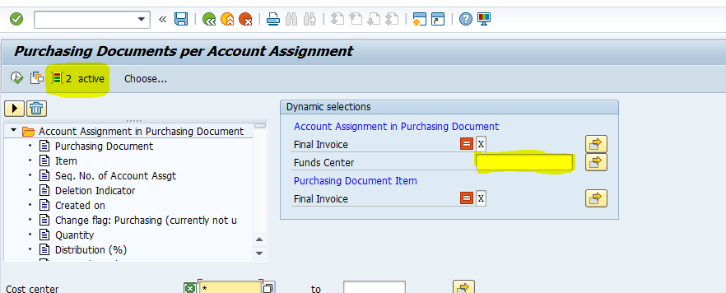
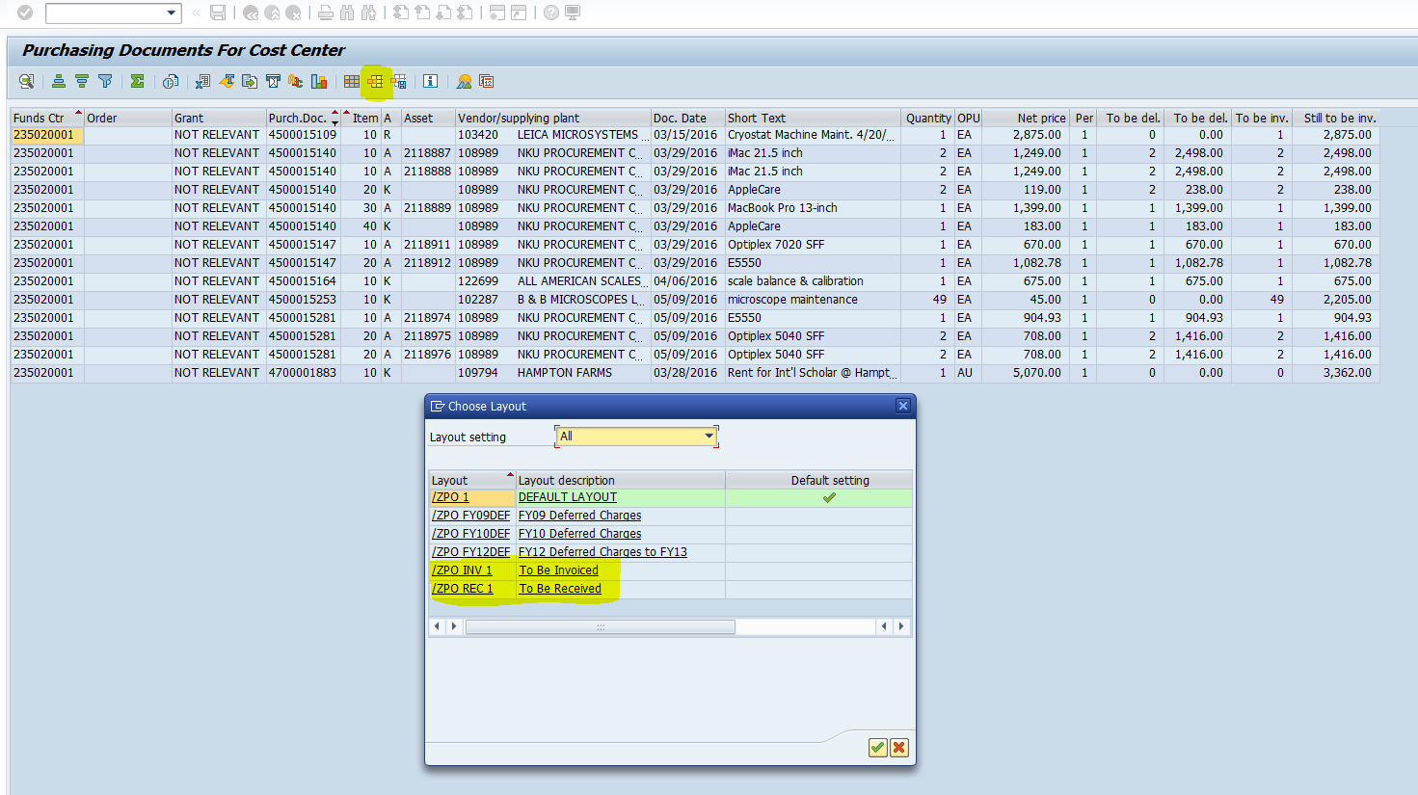
ZME2K
Notes:
To review open purchase orders, transaction ZME2K can be used.
Click the “Dynamic Selections” button to bring in the funds center field. Use the “Multiple Selction” button if you would like to run multiple funds centers at once.
Click the “Choose Layout” button to review P0’s that need to be received, or P0’s that need to be invoiced.
Any items that have been physically received, but appear on the “To Be Received” report, require a goods receipt to be posted by the department in SAP.
Any P0’s appearing on the “To Be Invoiced” report require an invoice document to be processed by Accounts Payable.

Slide 7
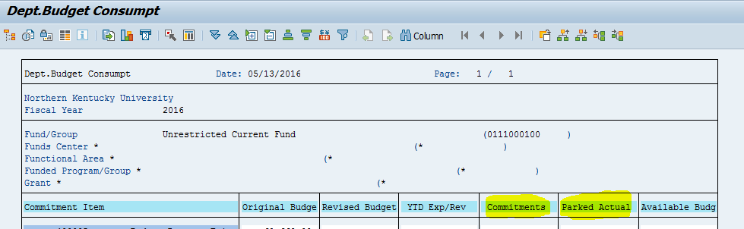
ZFBC
Notes:
Another way to review outstanding documents is through ZFBC.
Purchase orders, purchase requisitions and travel docs will appear in the “Commitments” column. When a purchase order has been invoiced or received, it will no longer appear in the commitments column. When a travel expense has been approved through Accounts Payable, it will no longer appear in the “Commitments” column.
Electronic interdepartmental bills and recodes will appear in the “Parked Actual” column. Once the electronic document has been approved at the final level of workflow, it will no longer appear in the “Parked Actuals” column.

Slide 8
Travel Request/Expenses
Commitments related to travel
  On June 27, all commitments related to travel will be deleted. This will not delete the trip but will free the budget that the trips once committed.
Outstanding Requests
  Review outstanding travel request to determine if the request should be deleted, or if an expense report should be submitted.
Outstanding Expenses
  Review any expense reports to move forward through workflow.
  All FY25 travel expenses must be submitted to Accounts Payable by July 7
Draft Trips
  All draft status trips for FY25 will be deleted on June 27
Notes:
Review all commitments in the travel lines.
Outstanding requests for trips in the past should be reviewed to determine if an expense report should be filed or if the request should be cancelled.
Review outstanding expenses to determine if further action is required by the department (additional receipts, explanation of expenses). If you have questions regarding outstanding expenses, please contact Accounts Payable.
FY25 travel expense reports are due to Accounts Payable by July 7.
Any FY25 trips in a draft status will be deleted on June 27.

Slide 9
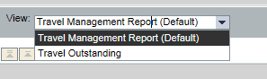
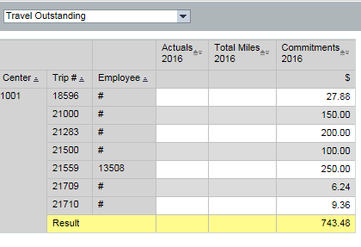
Travel Request/Expenses
Notes:
The BW Travel Management Report can be utilized to review the outstanding requests and expense reports by cost center and employee.

Slide 10
Deposits and Receivables
Deposits
  Please deliver all cash and checks to Student Account Services on or before noon on June 27.
  Please submit all credit cards deposits by July 7.
Receivables
  For payments that have not been received but are due to the University for services provided on or before June 30, please submit a Parked Customer Invoice by July 7.
Notes:
All cash received prior to the end of the fiscal year must be deposited with Student Account Services by noon on June 27.
Departments that take credit card deposits should submit June transactions to Student Account Services as soon as possible. All June credit card deposits must be turned in by July 7.
Please submit Parked Customer Invoices for outstanding receivables by July 7.

Slide 11
IBs/Recodes
Key Dates
  IBs must be initiated in workflow by July 7, workflow approvals must be completed by July 14.
  Recodes must be initiated in workflow by July 11, workflow approvals must be completed by July 16
Posting date
  When processing recodes on or before June 30, allow posting date to derive.
  After June 30, key in document and document line number. Press enter, and manually change posting date to 6/30/25.
  For IBs, use a document date of 6/30/25 for all FY25 documents processed in July.
Documentation
  Relevant supporting documentation must be attached
  Attachments must be Word, Excel, PDF or TXT
Notes:
Timing is critical at fiscal-year end. To the extent possible, initiators should work with the appropriate approvers to ensure all recode and interdepartmental bill requests are approved by the deadline. In order to finalize the closing process, all IB requests must be through the approval workflow by the end of the day on Monday, July 14. Recode requests must be through the approval workflow by the end of the day on Wednesday, July 16.
If a document is returned to the initiator, Financial Services will follow-up with the initiator to request the needed changes. The changes will need to be made in a timely manner to ensure the document completes the approval process by July 14 (interdepartmental bills)/July 16 (recodes).

Slide 12
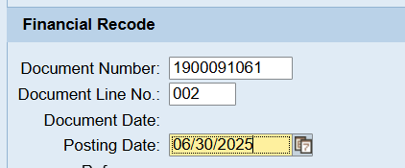
Recodes
Starting 7/1, manually enter posting date of 6/30/25 for FY25 recodes
Notes:
After June 30, the posting date must be entered manually for all FY25 recode requests. When initiating the request, populate the document number and line number fields and press the enter key. The posting date will default to the current date; override the posting date with June 30, 2025. This will put the recode in the correct fiscal year.

Slide 13
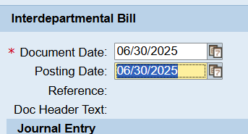
Interdepartmental Bills
Starting 7/1, use 6/30/25 as the document date for FY25 interdepartmental bills. Once enter is pressed, the posting date will derive to 6/30/25.
Notes:
On electronic interdepartmental bills, the document date drives the posting date. For FY22 IB’s initiated on or after July 1, use June 30 for the document date. This will put the IB in the correct fiscal year.

Slide 14
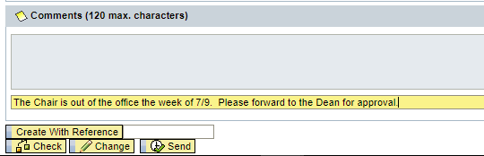
Electronic Approvals
Recodes/Interdepartmental Bills
When applicable, provide absence information in the comments field. The Office of Financial Services will forward to the next level approver based on the hierarchy.
Notes:
If an electronic IB or recode request is initiated, and an individual in the approval workflow is out of the office, please include this information in the comments. The Comptroller’s Office can manually forward to the next workflow level, based on the funds center hierarchy.
Note that this step is not necessary if a substitute approver is in place.

Slide 15
Other Expenses
PARS: ZHPA_PARS
  Please review PARs that have not completed the workflow process to ensure all approvals are obtained.
  PARs and other documents for special, extra, grant or any other type of compensation work performed in FY25 should be submitted to Human Resources by June 11 (biweekly) and June 13 (monthly).
Reallocation deadlines
  Reallocation deadlines are as follows:
    Pay dates 4/1/25 – 4/30/25; submit reallocation request by May 27
    Pay dates 5/1/25 – 5/31/25; submit request by June 10
    Pay dates 6/1/25 – 6/6/25; submit request by June 20
    Pay dates 6/7/25 – 6/20/25; submit request by July 8
    Pay date 6/21/25 - 7/18/25; submit request by July 16
Notes:
All PARs must be submitted to HR by June 8. PAR workflow can be reviewed using ZHPA_PARS. PARs in still in workflow will be reported with an “In Process” status.
Review payroll expenses on the BW Labor Distribution Report. If any errors are discovered, a reallocation can be requested.
April reallocation requests due by May 27
May reallocation requests due by June 10
June 1 – June 6 reallocation requests due by June 20
June 7 - June 20 – reallocation requests due by July 8
June 21 – July 18 – reallocation requests due by July 16

Slide 16
Budget Transfers
Budget transfers for FY25 must be received by the Office of Budget, Financial Planning and Analysis by the end of the day August 4.
Review budget transfers that are still in workflow via ZFB1, pre-posted column
Run the BW University Credit Balance Report to determine if there are any credit balances to address in your area.
Take note that two fiscal years will be open in July; please validate the fiscal year when processing budget transfers during this time frame.
Notes:
Budget transfers are due to the Budget Office by the end of the day August 4.
Run transaction ZFB1 to review budget transfers that are still in workflow (Status = Preposted).
The University Credit Balance report is available in BW to review for any credit balances in university funds centers.
When processing budget transfers in July/beginning of August, please remember two fiscal years are open. Before submitting a budget transfer, validate the fiscal year is accurate.

Slide 17
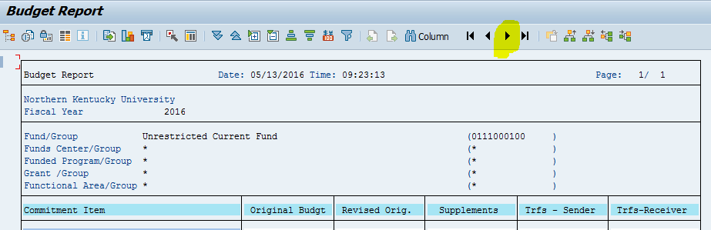
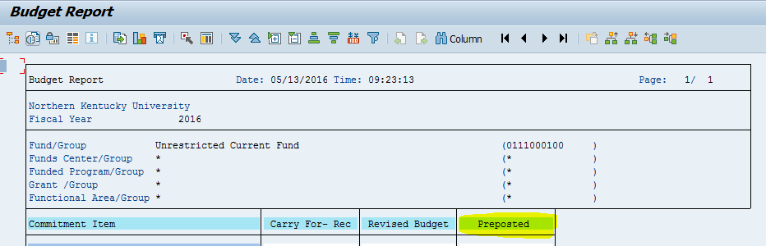
Budget Transfers
Notes:
To review budget transfers in workflow, run transaction ZFB1. Click the page right arrow towards the top middle of the screen. The preposted column will display budget transfers in process.

Slide 18
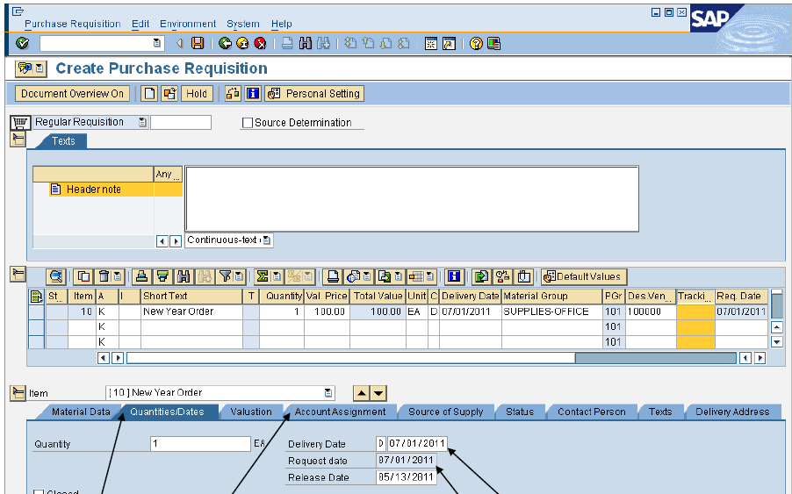
New Year Requisitions
Notes:
For new year requisitions, please ensure that both the request and delivery dates (under the Quantities/Dates tab) are 7/1/25 or later.
These dates should be changed prior to adding the Account Assignment data.

Slide 19
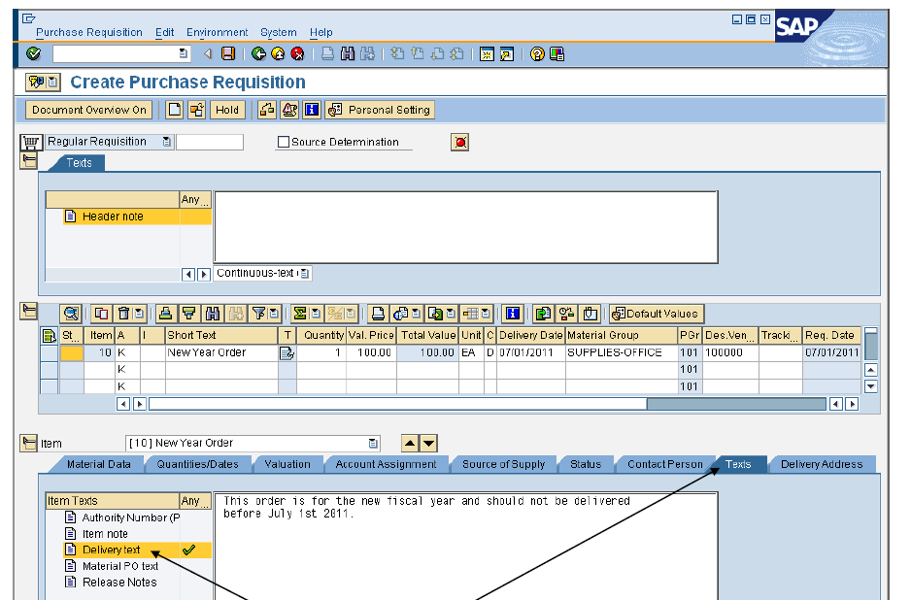
New Year Requisitions
Notes:
Please also include a note in the Delivery Text (under the Texts tab) advising the vendor that the item should be delivered on or after 7/1/25.

Slide 20
QUESTIONS?
Office of Financial Services website
Notes:
Thank you again for your time. If you think of any additional questions, please feel free to contact the Comptroller’s Office.

