Slide 1
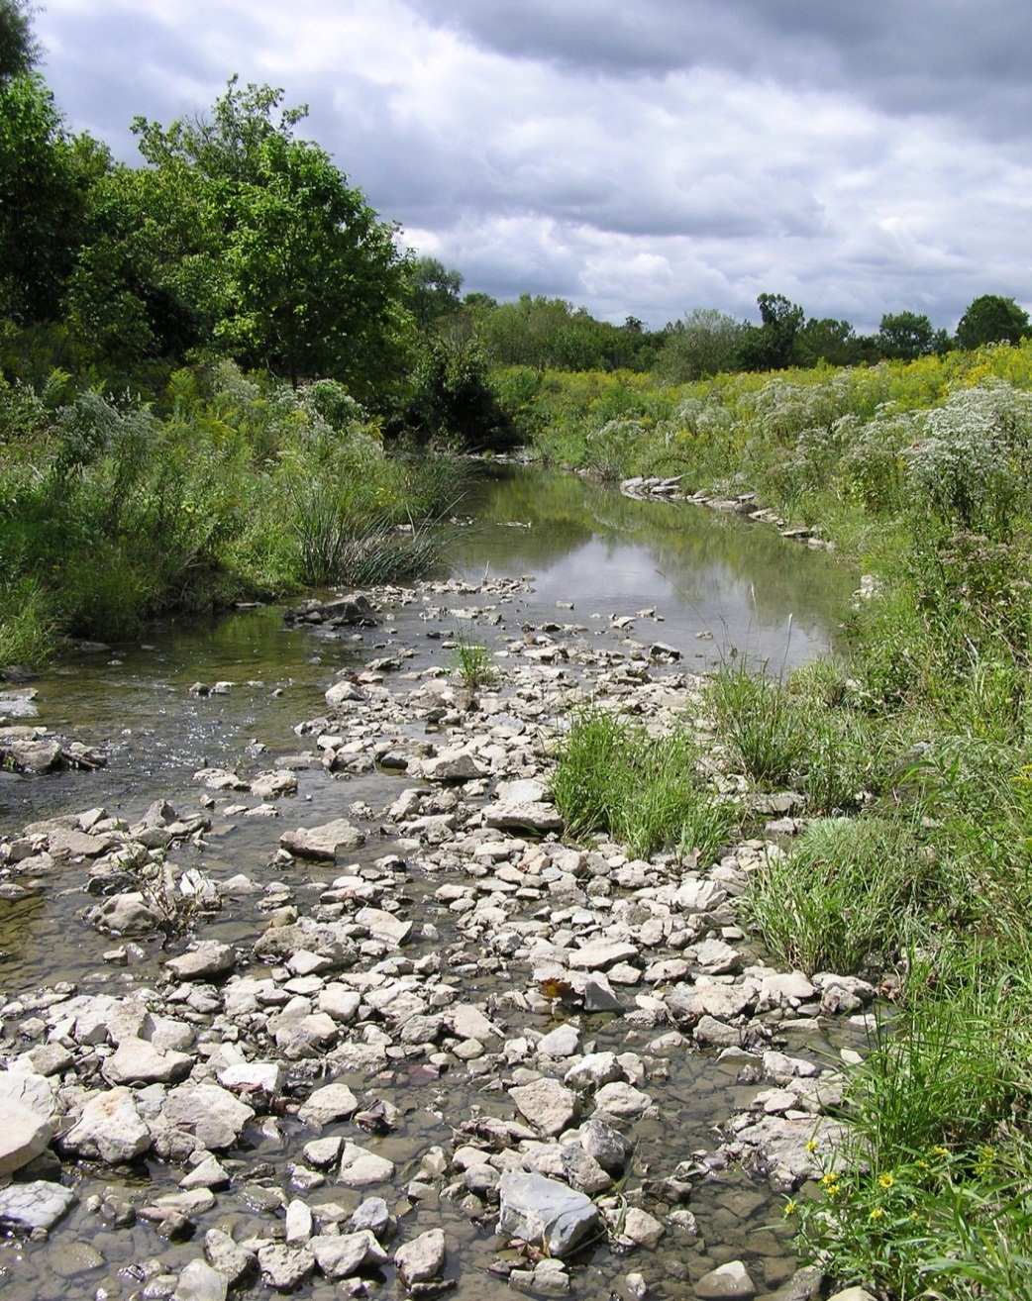

NKU Stream Restoration Program Scott Fennell, PE Director / Senior Engineer
Northern Kentucky University Center for Environmental Restoration

Slide 2
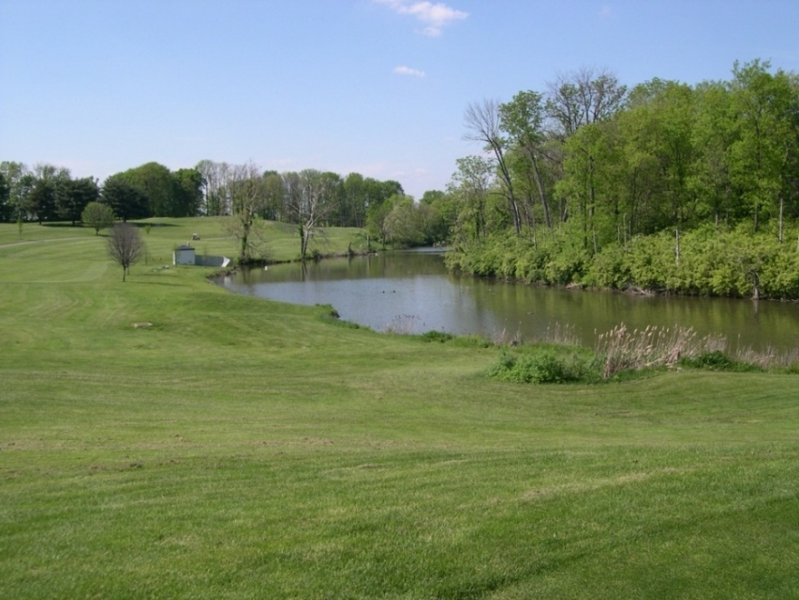
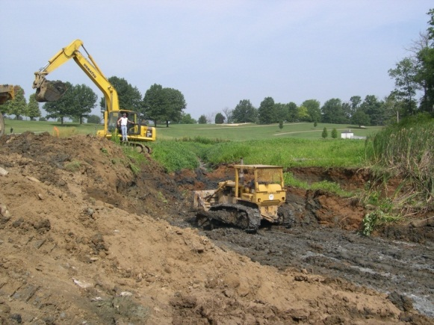
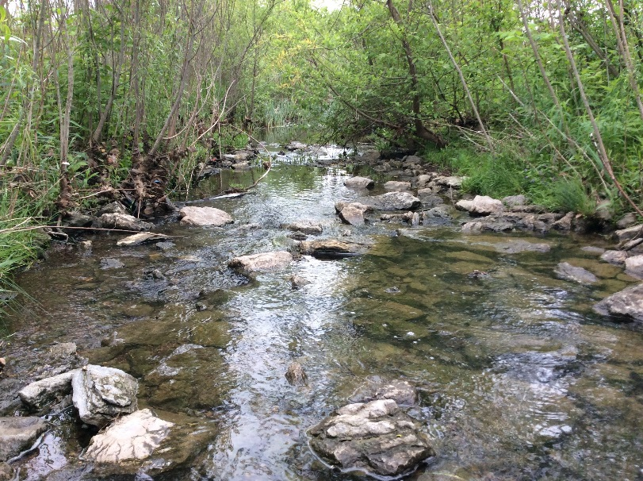
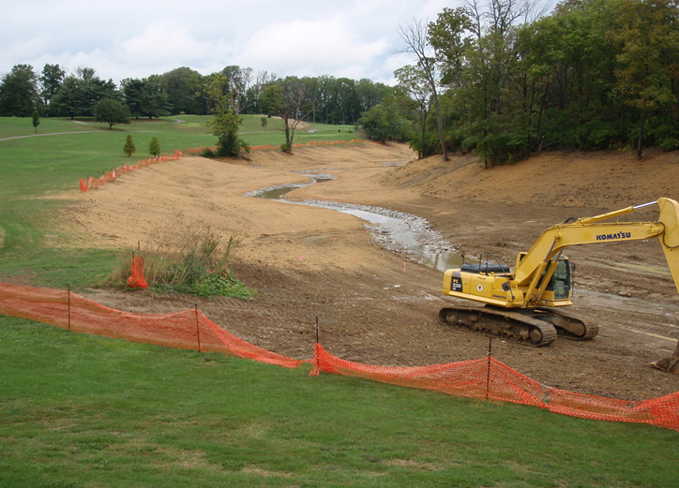
City of Florence Golf Course Lake & Sediment Removed; Floodplain, Meandering Channel, & Forest Buffer Restored
Before
During
After 16 Years
During
Rosgen C Channel Restoration

Slide 3
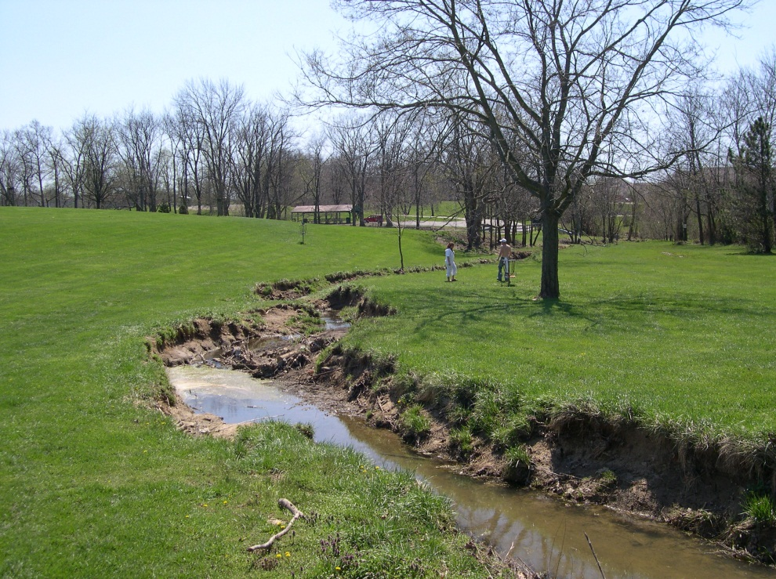
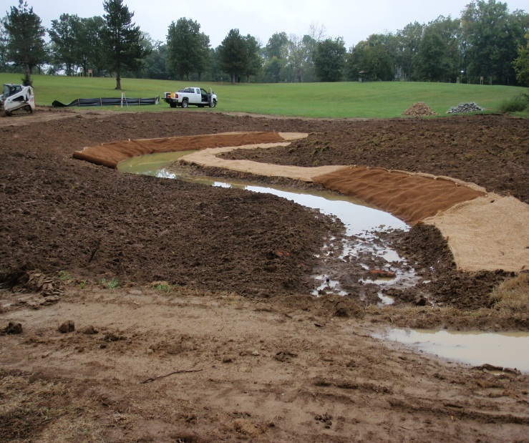
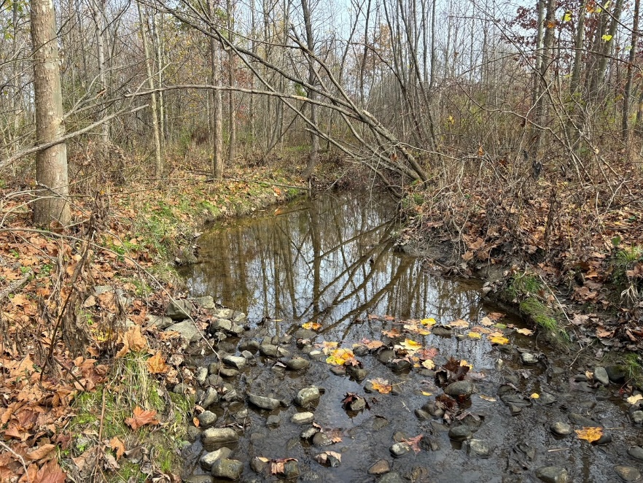
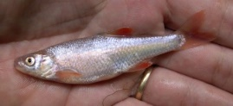
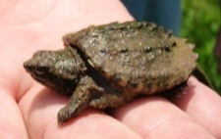
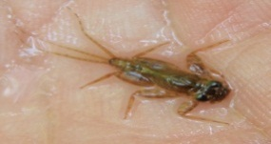
Boone Woods Park – North Branch of Allen Fork Floodplain, Meandering Channel, Riffle/Pool Complex, and Forest Buffer Restored
Before
During
Rosgen C/E Channel Restoration
After 14 Years

Slide 4
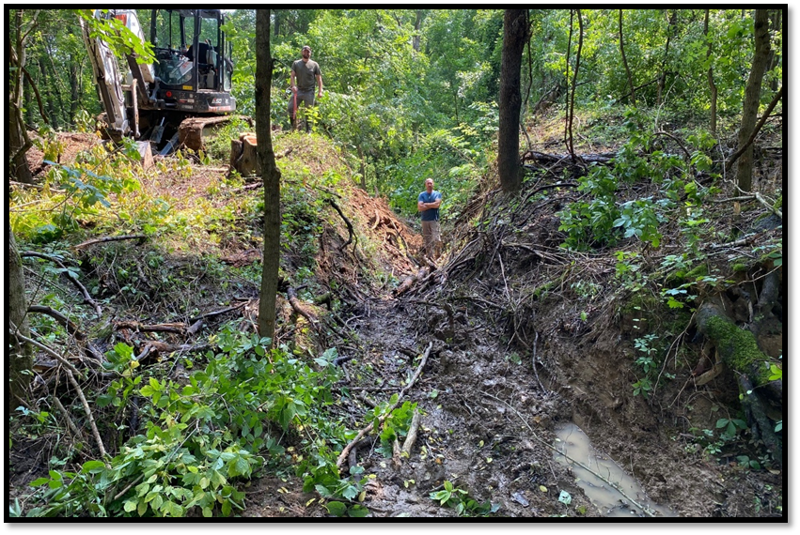
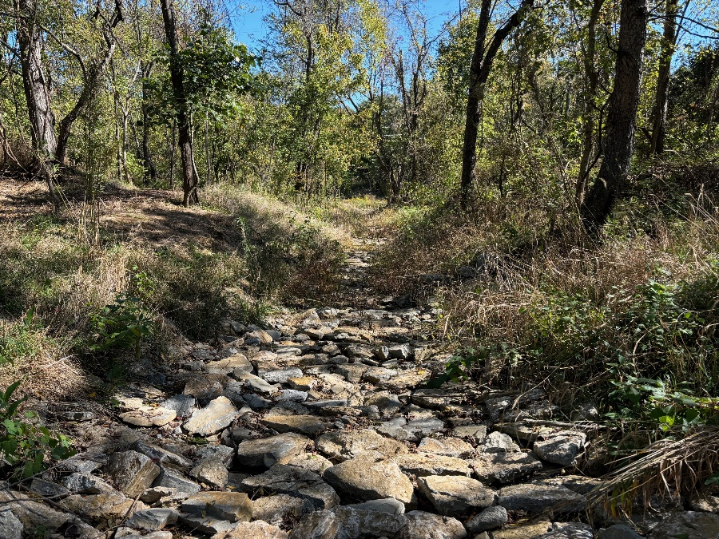
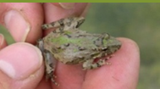
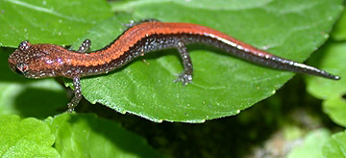
Central Park / Boone County Arboretum
Stream Restored by Removal of Pond Sediment & 10-foot Breached Dam and Placement of Rock Substrate
Before
After
Rosgen B Channel Restoration

Slide 5
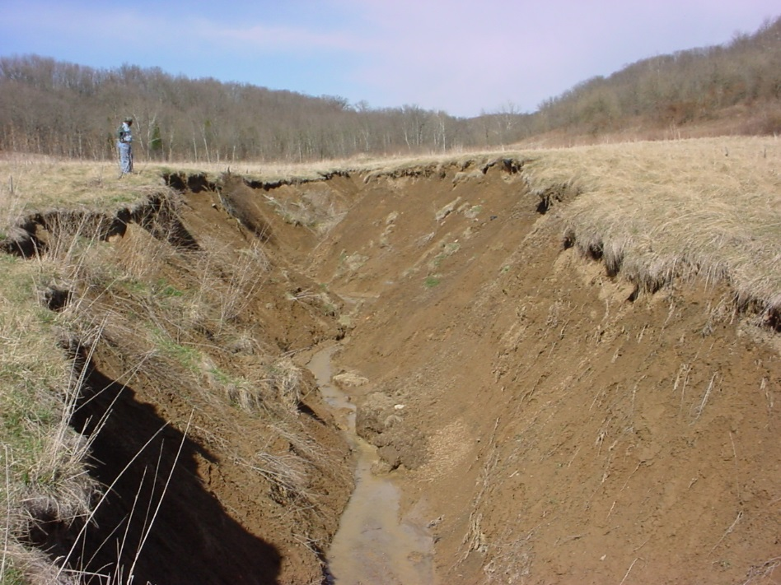
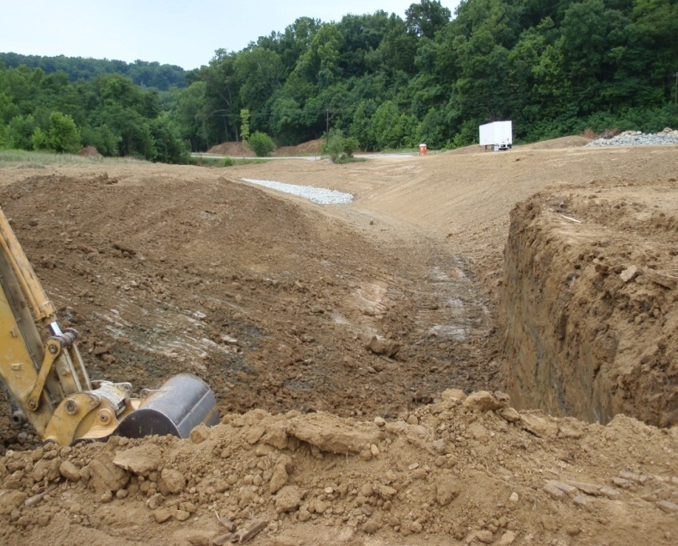
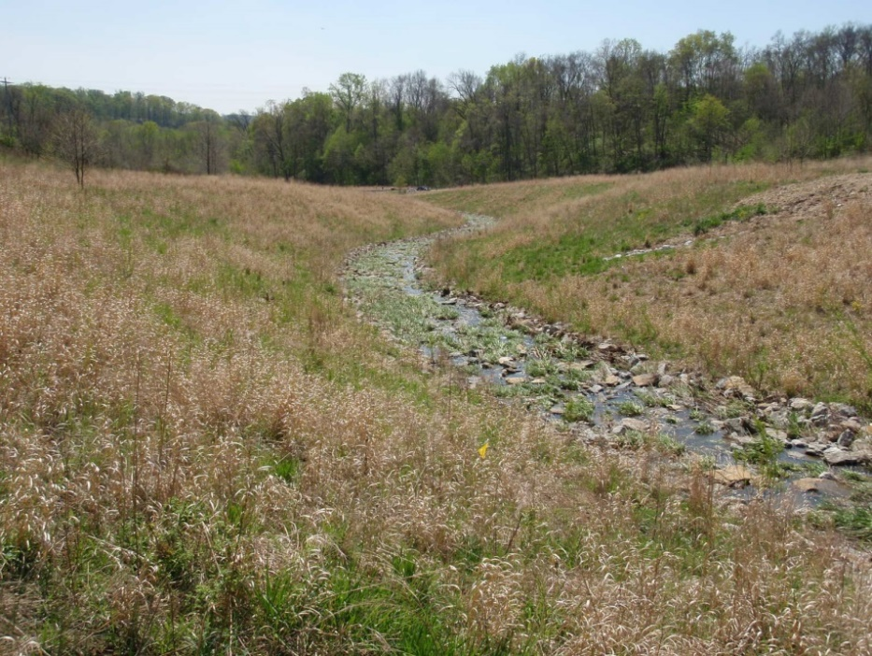
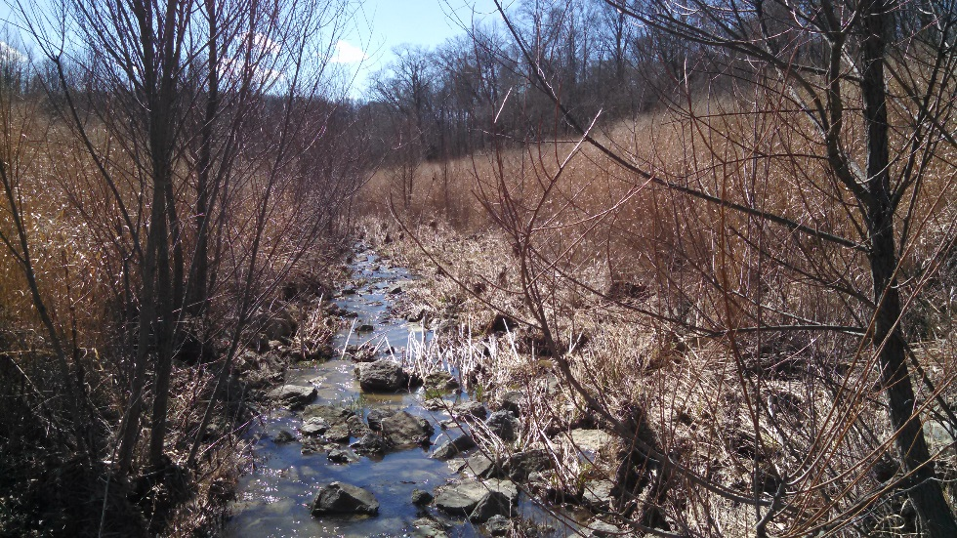
Split Rock Conservancy Stream & Native Meadow Buffer Restored at Severely Entrenched Fill Site Gully
Before
During
After 10 Years
After
Rosgen B/A Channel Restoration

Slide 6
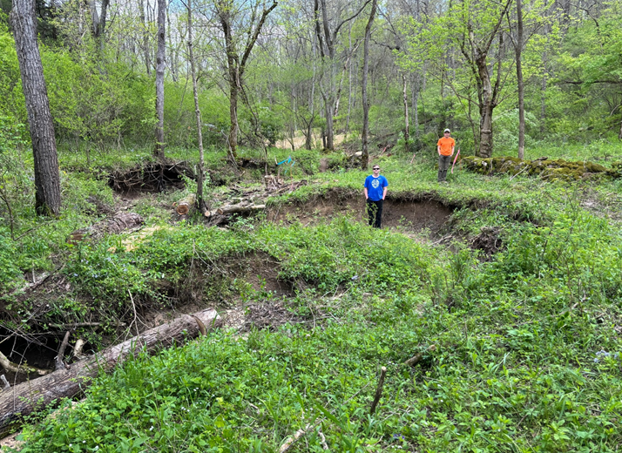
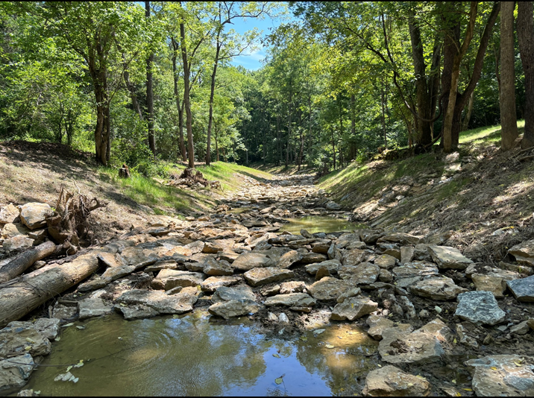
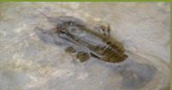
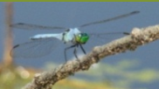
Kingsolver Wildlife Management Area
Stream Restored through Seven Feet of Legacy (Farm) Sediments
Before
After
Rosgen B Channel Restoration

Slide 7
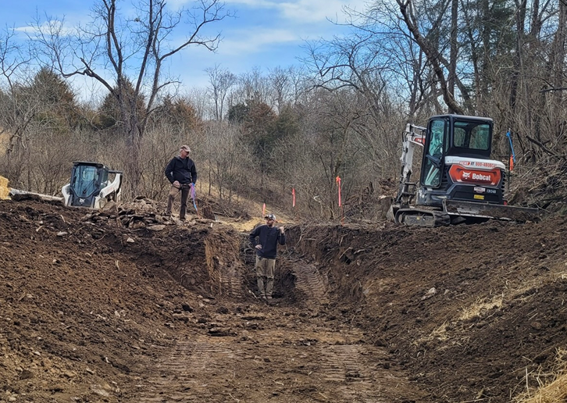
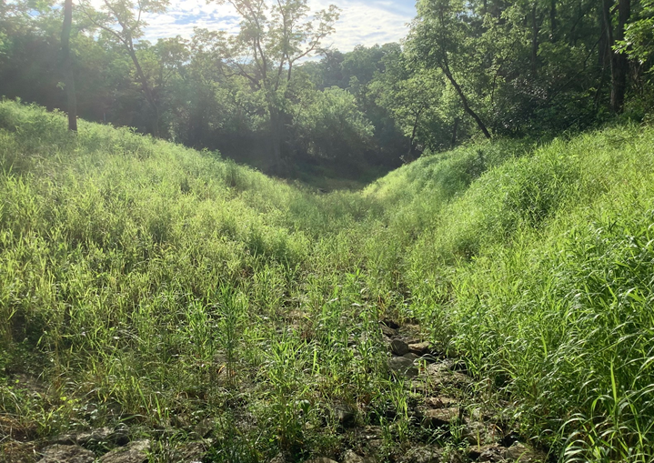
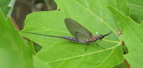
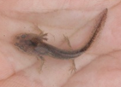
Sleepy Hollow Conservancy
Stream Restored through Five Feet of Legacy (Farm) Sediments
Before
After
Rosgen A Channel Restoration

Slide 8
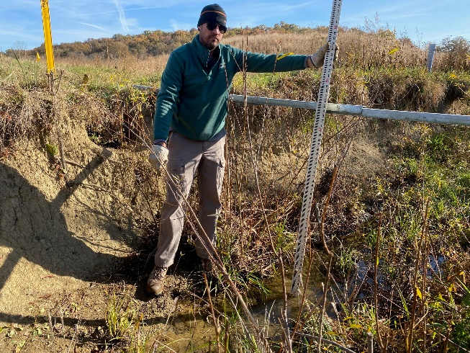
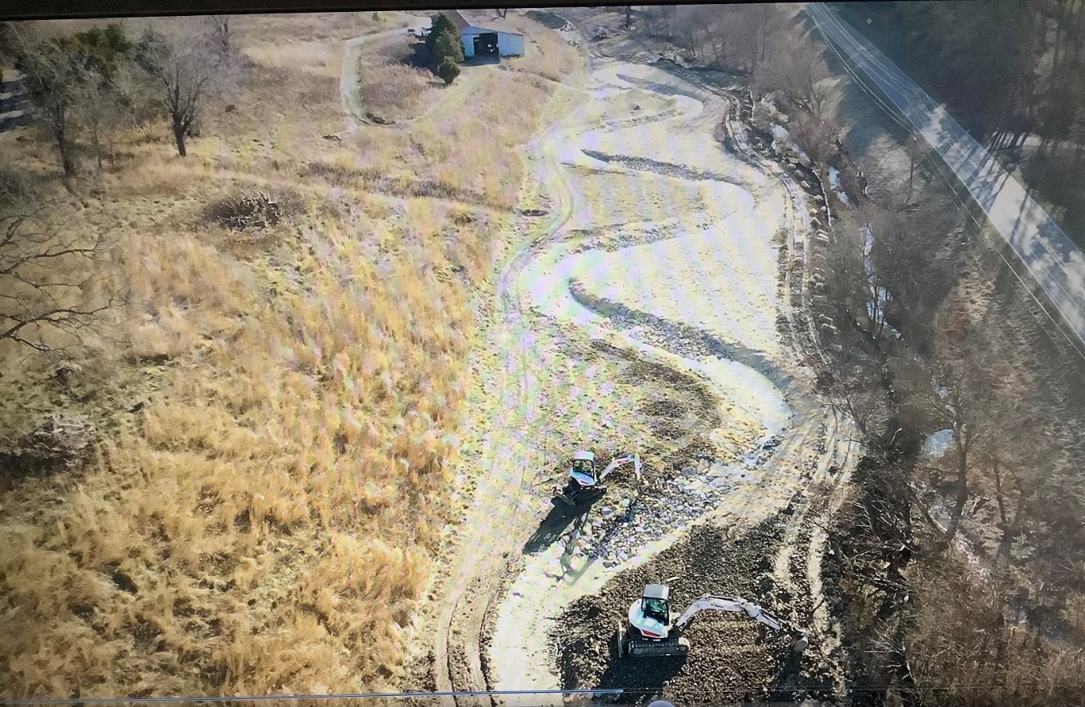
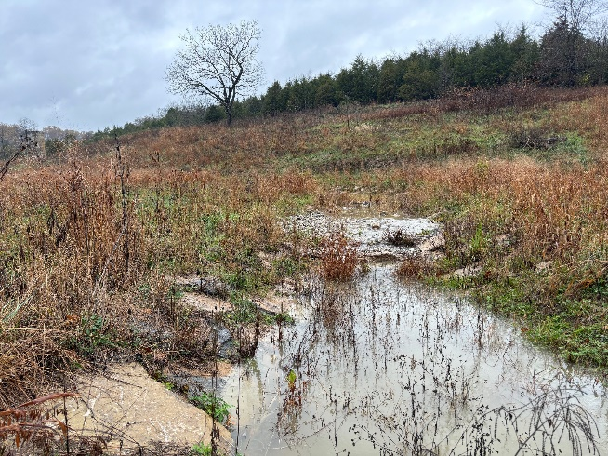
Big Bone State Park - Phase 3 (Piner)
Floodplain, Meandering Stream, Riffle/Pool Complex, and Native Cane & Meadow Riparian Buffer Restored “Offline” from Channelized Reach
Photo upper left: typical channelized reach incised 4.5 feet before restoration.
Photo right: floodplain, meandering channel, & riffle/pool complex during restoration. Photo lower left: typical riffle (center) & pool (foreground) four months after restoration.
Rosgen C Channel Restoration

Slide 9
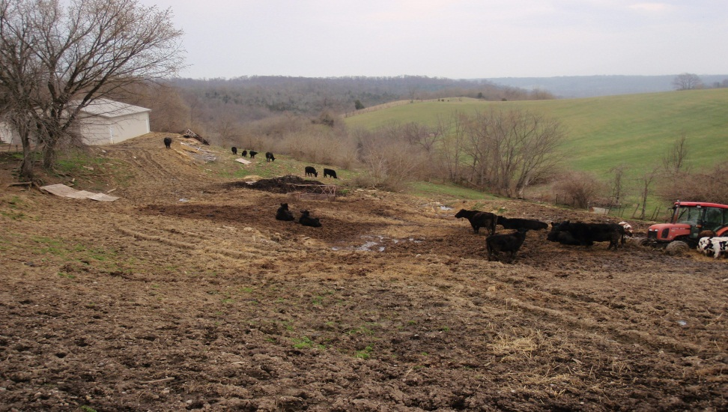
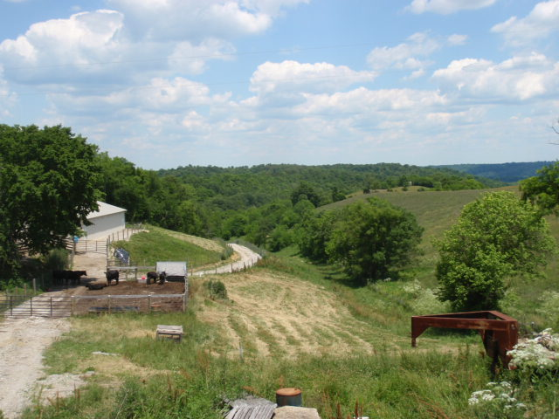
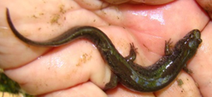
Wright Farm
Streams Restored and Best Management Practices Installed including Heavy Use Area & Grass Filter, Water Supply, Critical Area Planting, Stream Buffer Plantings, and Buffer Exclusion Fencing
Before
After

Slide 10
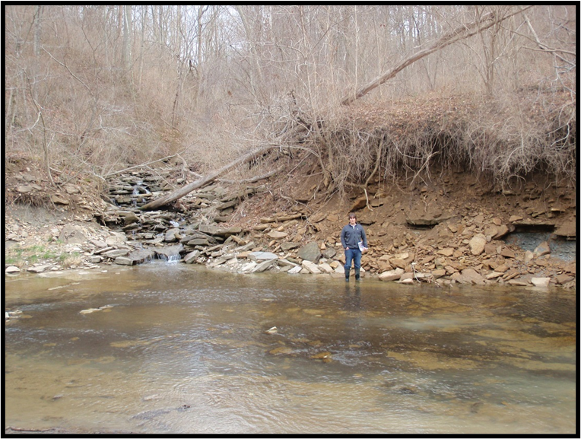
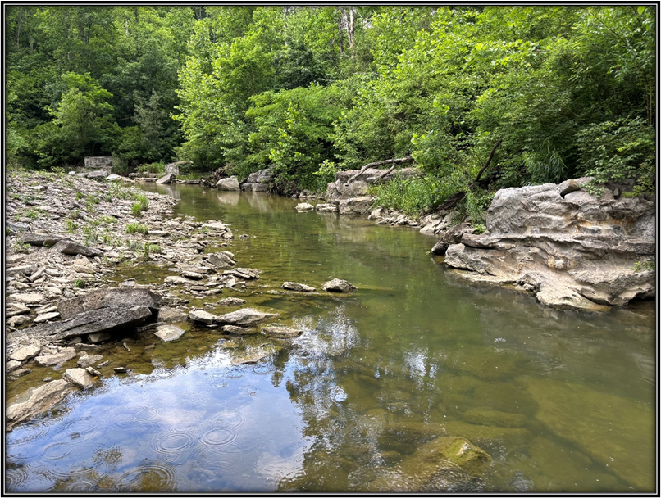
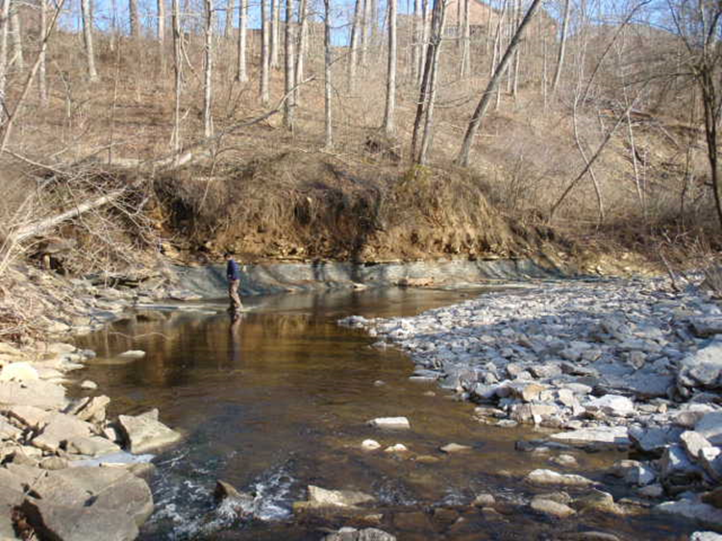
Bullock Pen Preserve
Bullock Pen Creek Major Bank Erosion Stabilization
Before
After
Before
Photo upper left: Looking downstream, view from right descending bank of severe bank erosion (approximately 15 feet) on left descending.
Photo lower left: Looking downstream, view of severe bank erosion on left descending bank.
Photo right: Looking upstream, view of stabilized banks post-construction

Slide 11
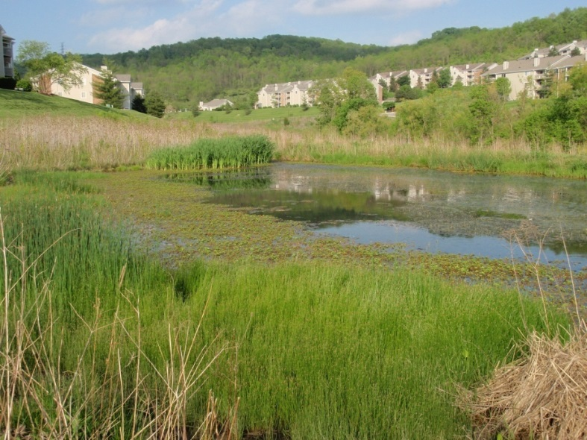
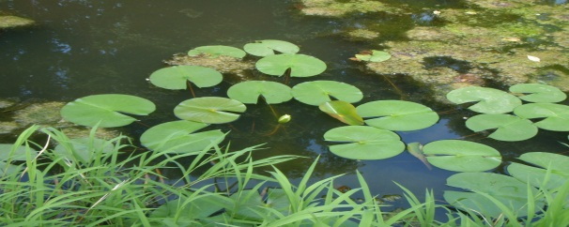
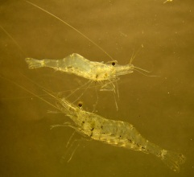
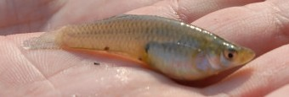
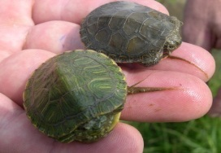
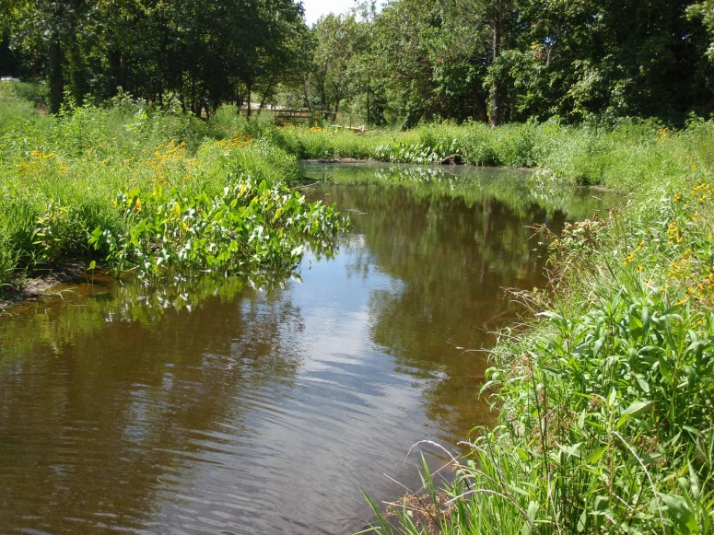
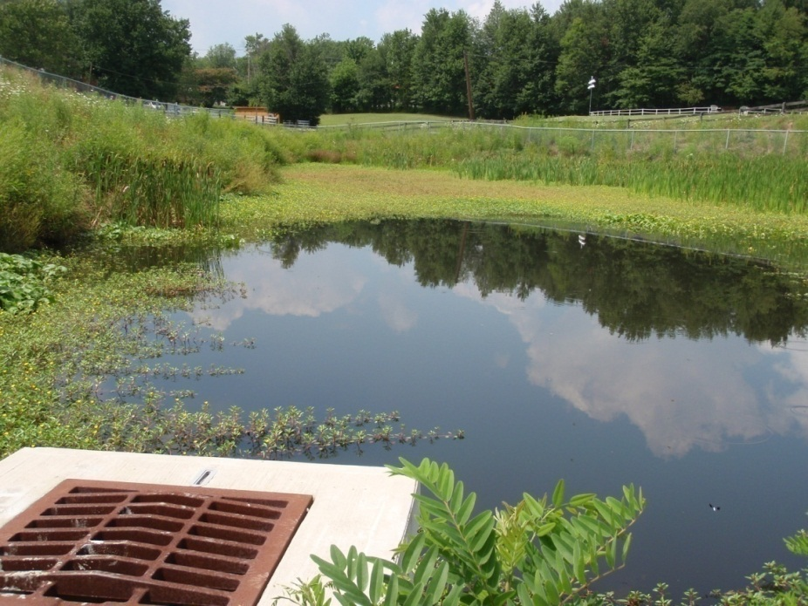
Suburban Stormwater Wetlands Created, Providing Water Quality Improvement and Habitat
Bentwood
Boone Woods Park
Burlington Elementary

Slide 12
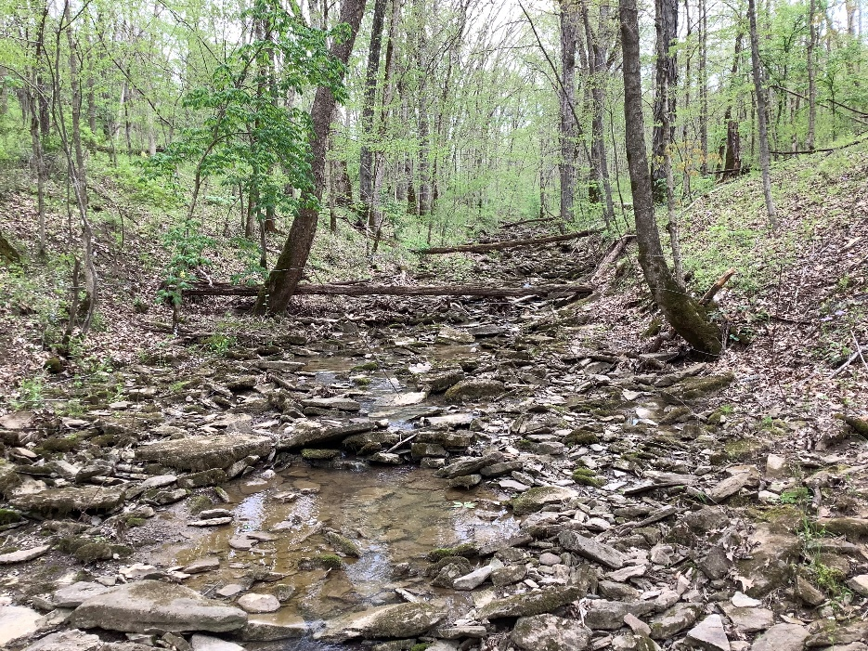
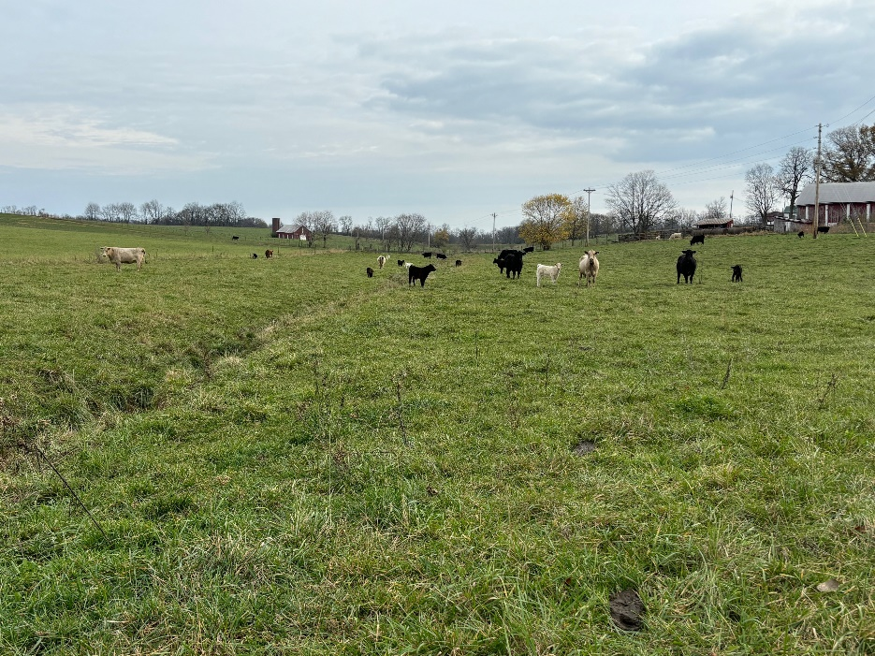
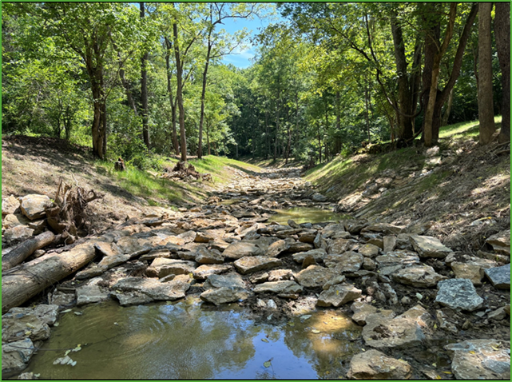
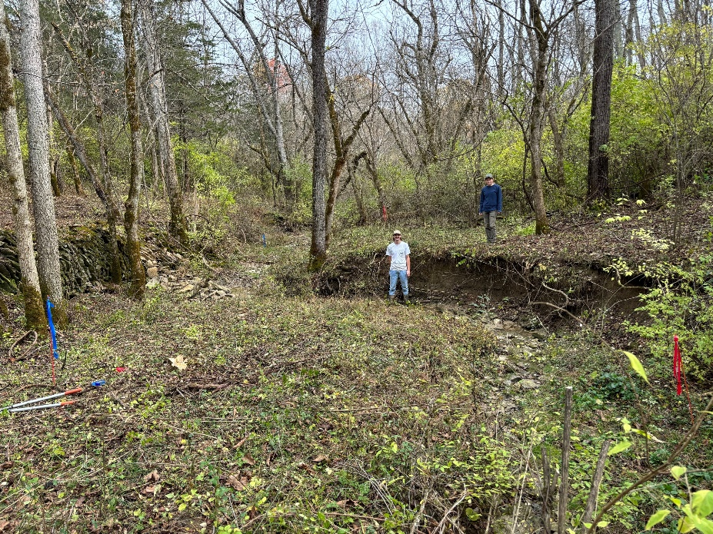
Typical Sequence of Rosgen B Channel History in Northern Kentucky:
Example 100-acre +/- Watershed
Natural Stream and Riparian Condition
100% Impact Condition
Immediately After Restoration
Protracted Natural Recovery Condition

