Slide 1
Human Resources Quick Reference
New Hires: How to Enroll for Your Benefits
To enroll in your benefits for the designated year, refer to the following steps:
From the Intranet, do one of the following:
Type myNKU.nku.edu in the address field and hit Enter; or
From the NKU Home Page, click the Quick Links drop-down, click myNKU.

Slide 2
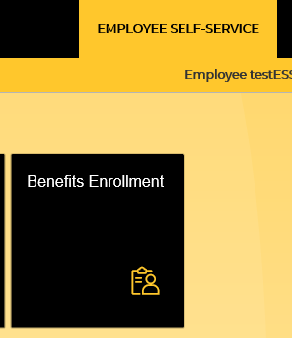
Human Resources Quick Reference
New Hires: How to Enroll for Your Benefits
Type your NKU network user ID and password in to appropriate fields as illustrated here.
Click Sign-in.
Click Employee Self-Service tab.
Click Benefits Enrollment.

Slide 3
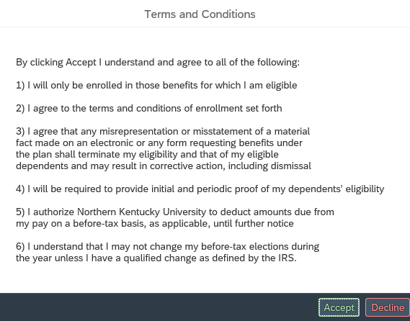
Human Resources Quick Reference
New Hires: How to Enroll for Your Benefits
Click Hire under the Benefits section.
Read the Terms and Conditions textbox and do one of the following:
To accept the terms and conditions:
Click Accept.
To not accept the terms and conditions:
Click Decline, which will then not allow you to move on to the enrollment process.
End of procedure. May want to return to Benefits Enrollment tile, if wanting to enroll.

Slide 4
Human Resources Quick Reference
New Hires: How to Enroll for Your Benefits
Click on Next.
9. Select the benefit to enroll in and click on Opt In.
10. Select coverage option and click on Confirm Selection.
11. Once you have enrolled in your chosen benefits, click Next on the benefits home screen.
12. Confirm your selections and click on Enroll.

Slide 5
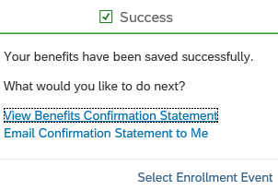
Human Resources Quick Reference
New Hires: How to Enroll for Your Benefits
13. You can either view your benefits confirmation statement or have it emailed to your NKU email address.
14. Click on Select Enrollment Event to return to the home screen.
15. Click Logoff button at the top-right side of the screen to logoff of the system. If you do not logoff appropriately, If you do not log off your elections will not be saved.

