Slide 1
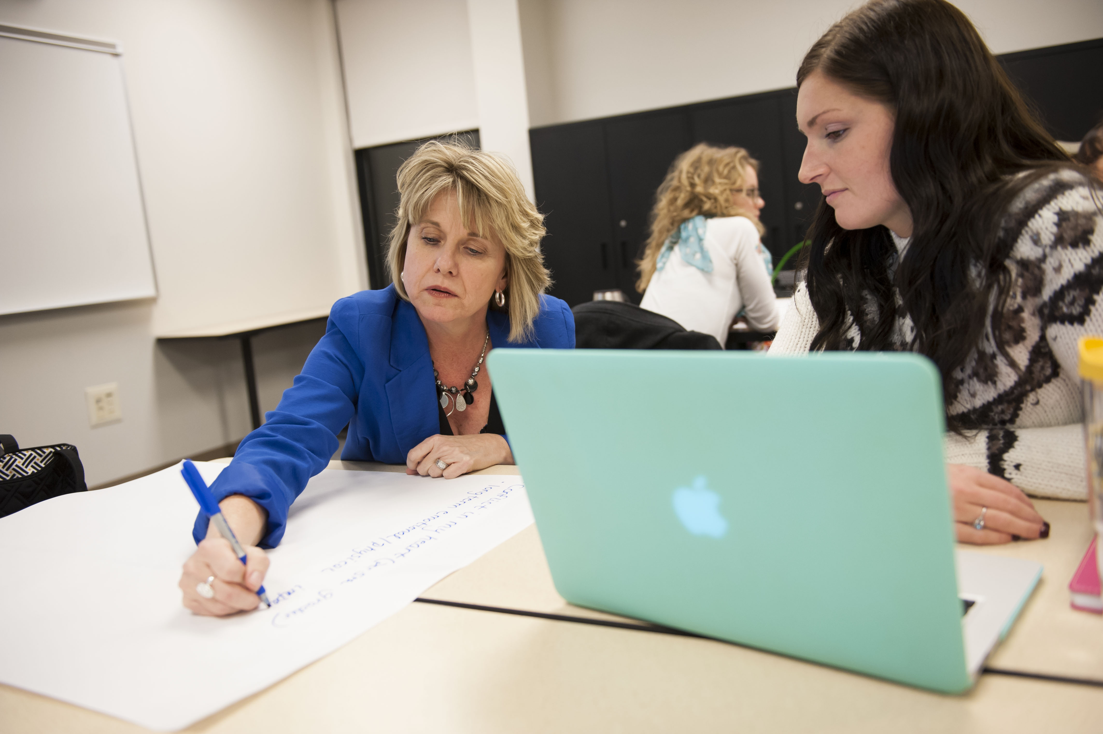
Arial can substituted if Veneer and Avenir are not available. Delete this box when ready.
Title
Headline
WHERE:
Location
WHEN:
Time
Change picture and make sure photo is sent to the back. Delete this box when ready.
Reserve your spot: NKU.edu

